Slide 1
Trade and Globalization
Mina Kim, Ph.D.
American University OLLI
March 9, 2026
Notes:
Today I will be talking to you about Globalization and trade.
You may have noticed prominent commentators either extolling or decrying the effects of globalization on communities or nations. Mostly it seems like the latter in more recent times. As the first quarter of the twenty-first century draws to a close, global economic integration faces many challenges. These include the COVID-19 pandemic and associated nationalism surrounding PPE and vaccines; Russia’s war in Ukraine and the hesitancy of some governments to take more decisive action to cut Russia’s access to export revenues; and the fragility of geographically dispersed supply chain production. But these are symptoms, rather than causes, of a longer-term erosion of support for global economic integration.
And Biden’s trade policy agenda has seemed to be in response to that. We’ll talk about that later in the course.
Sometimes it’s useful to look back at what’s happened in order to understand where we are today. That is what we’ll be doing for this session.
But what is globalization?
The growing interdependence of the world’s:
Economies
Cultures
Populations
Brought about by cross-border flows of:
Goods and services
Technology
Investment
People
Information
There are primarily three forces driving globalization.
The first is innovations in transportation. Over time, transportation technologies increase in speed and efficiency, driving down the costs of transportation. The cheaper it is to move goods and people across borders, the more people will contemplate doing it.
The second is technology. Technology primarily in the form of communications. The easier it is to communicate between countries, the greater will be the awareness of opportunities for exchange or migration. Communications technology in the form of the internet has also become very important for facilitating trade in services.
Finally, international cooperation goes a long way towards facilitating globalization. The friendlier are the terms on which people, goods, services, and investments move across borders, the more movement of each will occur.
This presentation focuses on the economic aspects of globalization, or the exchange of goods, services, and money across international borders, and the consequences of these flows for the American policy.
How many of you are wearing shoes made in a different country than where you live?
How many of you are wearing clothing made in a different country than where you live?
Then this next slide is not surprising…

Slide 2
Source: Fouquin and Hugot (CEPII 2016)

Slide 3
First wave
Comparative Advantage
Source: Fouquin and Hugot (CEPII 2016)

Slide 4
De-Globalization
Source: Fouquin and Hugot (CEPII 2016)

Slide 5
Second Wave
Intra-industry
Source: Fouquin and Hugot (CEPII 2016)

Slide 6
Third Wave
GVC
Source: Fouquin and Hugot (CEPII 2016)

Slide 7
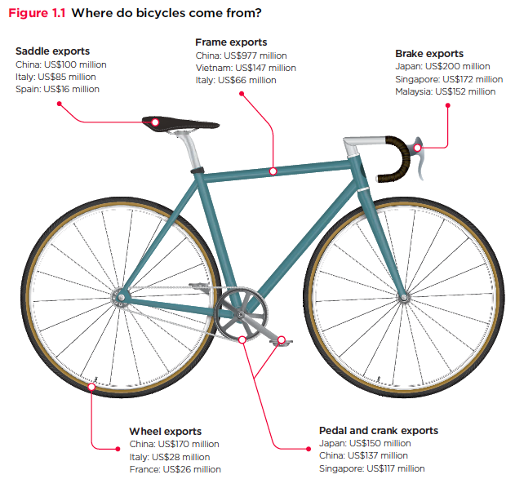
Source: World Development Report 2020

Slide 8
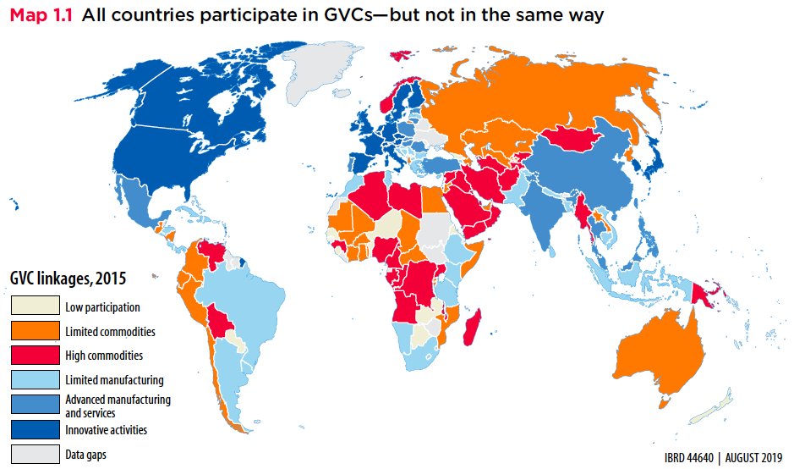
Export Volume Worldwide in Billions of US Dollars, 1950-2018
Source: World Development Report 2020

Slide 9
Slobalization
Source: Fouquin and Hugot (CEPII 2016)

Slide 10
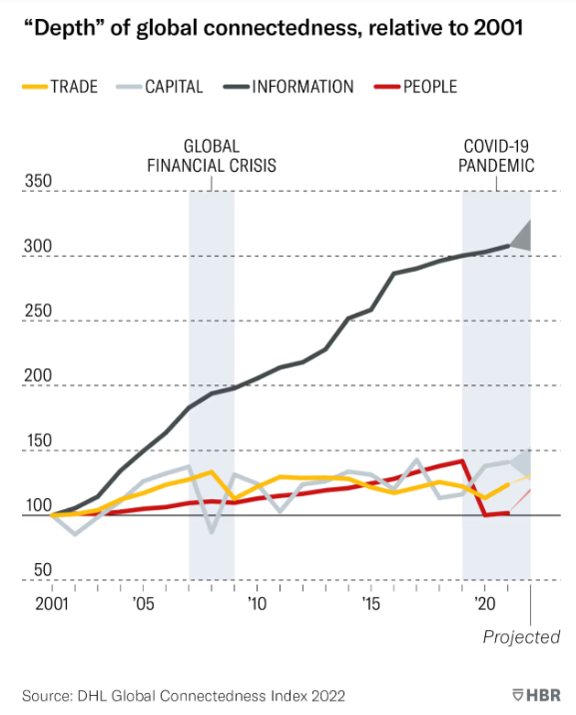

Slide 11


Slide 12
Why Do Countries Trade?
Competition
Varieties
Efficiency

Slide 13
Why Might Efficiency Differ Across Countries?
Labor
Skilled or unskilled
Technology
Some countries have firms that produce some goods well
Other countries have firms that produce other goods well
Environment
Cold/Warm Wet/Dry Sunny/Cloudy
Land
Rocky, soil, fertile, barren
Tundra, desert, grasslands, forest

Slide 14
Comparative Advantage and Specialization
Comparative advantage
Scarce resources: can't produce unlimited amounts of goods
Export goods where production advantage largest (or disadvantage weakest)
Non-econ example: Babe Ruth
Top pitcher during 1916-1918. But best hitter of all time!
Scarce resources: training time
Post 1918, Babe Ruth specialized as hitter
Econ example: US-UK trade in 1951
For same output, US used less resources than UK in each of 26 manuf sectors!
But, US net exporter to UK only for sectors where it’s advantage largest
UK net exporter to US for goods where it’s disadvantage weakest

Slide 15
Benefits of Specialization
For goods where US production advantage weakest…
US can consume these goods by either
Importing them from UK
Producing them and reducing production of goods exported to UK
Key point
US can consume more of these goods by importing them from UK
Analogous story true for UK
Trade increases size of economic pie for both countries

Slide 16


Trade Contributes to Growth
EFFICIENCY:
Allocates production across countries efficiently so that countries can specialize in what they are best at producing.
Varieties
More choice for consumers.
Better inputs for our production.
Competition
Brings in cheaper goods.
Makes consumers better off.
Economies of Scale
Trade makes some industries bigger, more cost efficient. Lowers prices.

Slide 17
What Does the Data Say? Trade Lowers Prices for Consumers
Effect of import surge from China: 2000-2007
Prices would be about 10% higher without this import surge.
Benefits for U.S. consumers of $100,000 per lost manufacturing job.
Do rich or poor benefit more from lower import prices?
Evidence is mixed.

Slide 18


Why has the public been turning against trade?

Slide 19
Intuition on Distributional Impacts
Jobs
U.S. imports more of some goods
Reduces jobs on those industries
U.S. exports more of other goods
Creates jobs in those industries
Are there different kinds of workers in these different industries?
Creates adjustment costs
Prices
LOWERS the price on imported products
RAISES the price on exported products
Who buys which products?

Slide 20


Slide 21



Covid Shortages

Slide 22
Supply Chain Trends and Consequences
The trend towards reducing costs: has resulted in the globalization of supply chains, making supply chains more vulnerable and complex.
The trend towards outsourcing non-core business activities: has resulted in loss of control when it is most needed).
The trend towards just-in-time and lean practices: has resulted in efficiency rather than effectiveness.
The trend towards the consolidation of suppliers: has resulted in the increased potential for supplier failure.

Slide 23
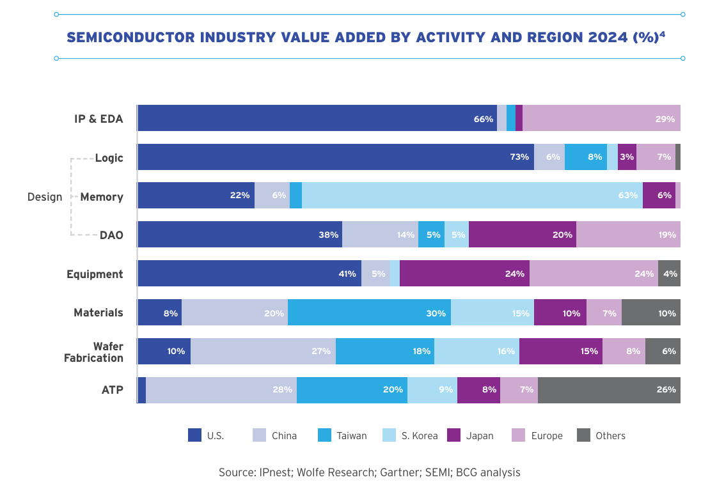
Semiconductor Story

Slide 24
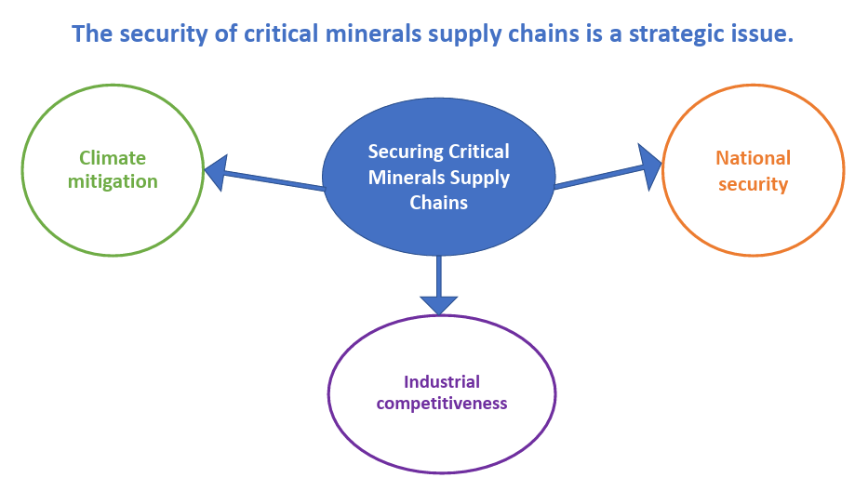

Slide 25
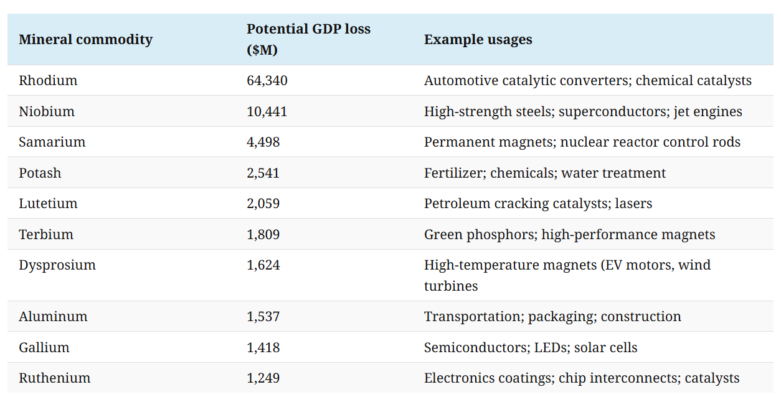
Critical Minerals

Slide 26
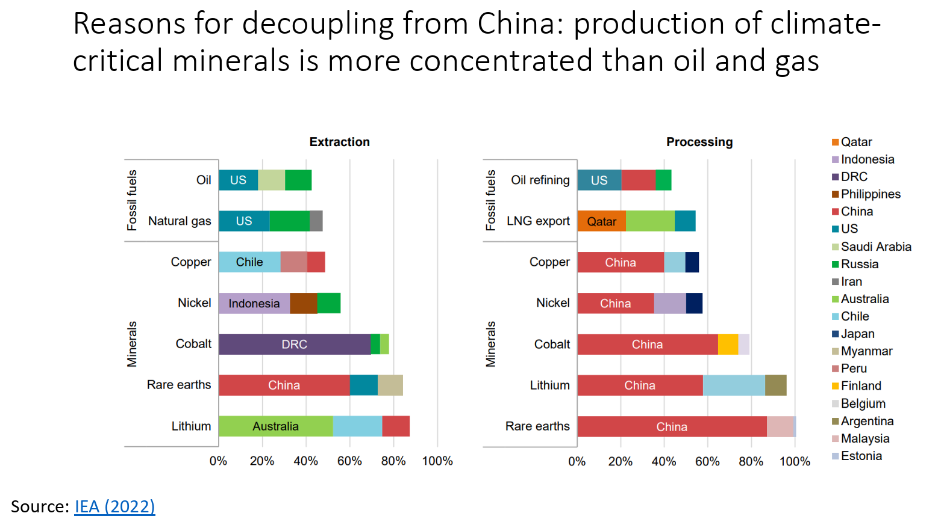

Slide 27
PRC Measures to Develop Midstream and Downstream
The 7th National Five-Year Plan for Rare Earth Industry (1986–1990)
Investment policies
State-sponsored R&D investment
Export tax & value-added tax
Export quotas (1999-2014) & production quotas (2006-present)
“Made in China 2025” industrial initiative (2015)
China’s production of rare-earth end-use products grew by about 70%, 2005-2015.
Chinese rare earth consumption growth: 7.5% p.a. (2004-2014)
By 2015, domestic consumption accounted for over 80 percent of the domestic production of rare earths.
National Mineral Resource Plan for 2016–2020
Export control law (Oct 2020)
Legislation to “reinforce the protection of its rare earth resources” and “strengthen full industrial chain regulation” (Jan. 2021)

Slide 28
The Consequences of Chinese Domination of the Minerals Market
Sept 2020 – China restricted REE exports to Japan
August 2023 – Export bans on gallium and germanium products.
Oct 2025 - Foreign firms required to obtain Chinese government approval to export magnets that contain even trace amounts of Chinese-origin rare earth materials
Jan 2026 – China targeted Japan with export restrictions on dual-use technologies

Slide 29
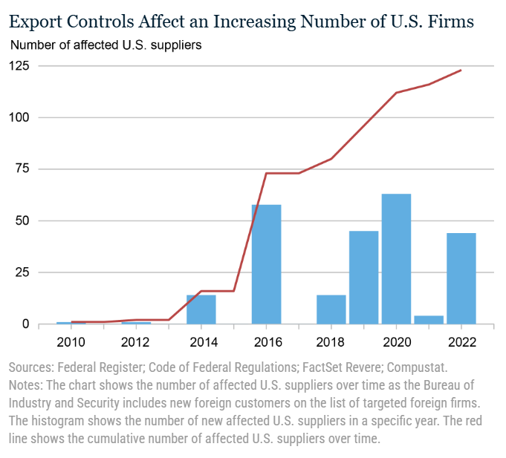
Export Controls

Slide 30
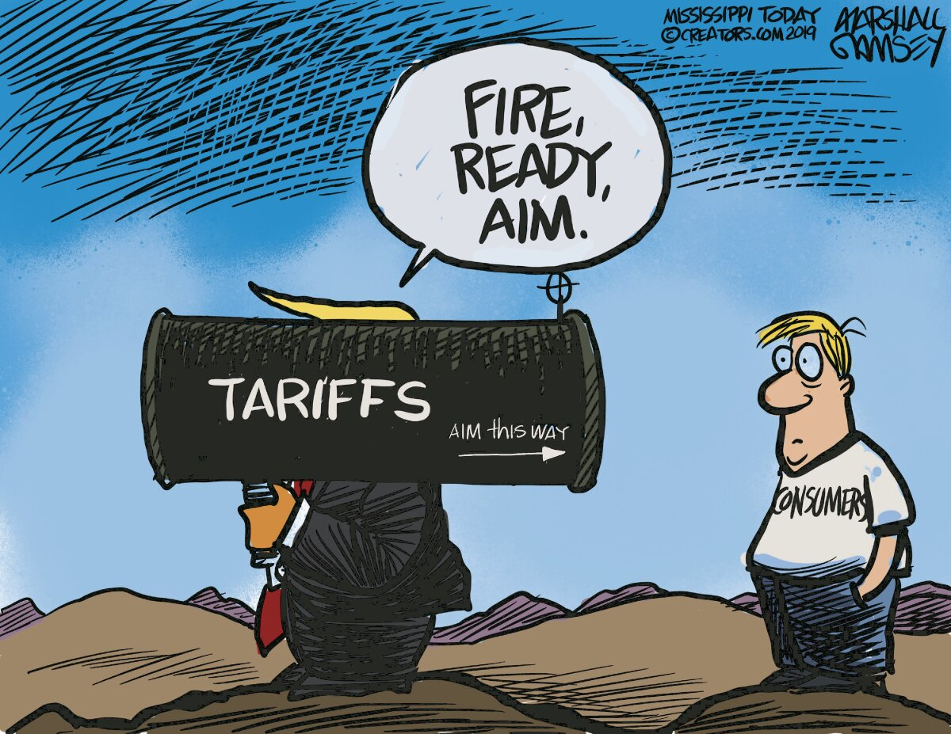

Slide 31
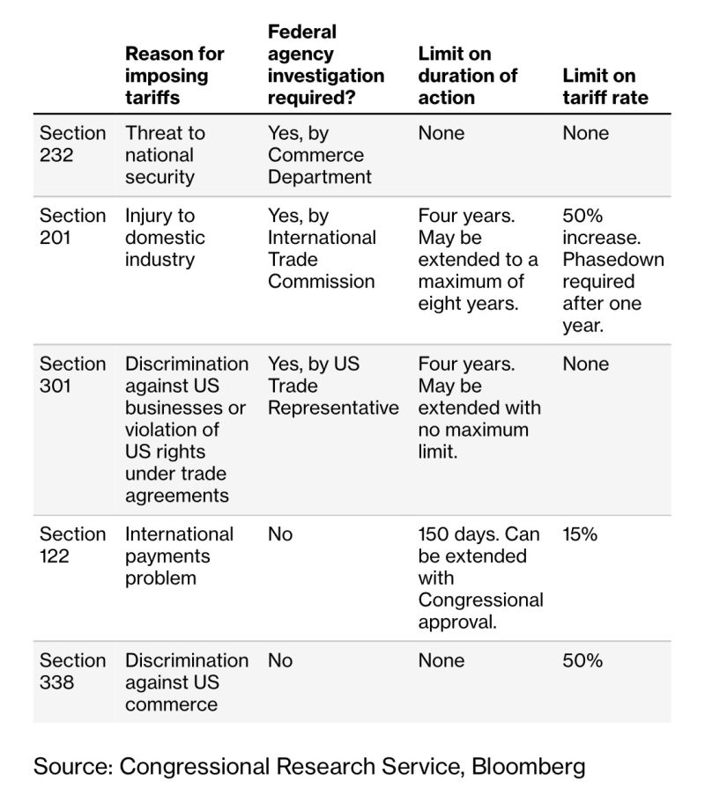
Legal Authority to support tariffs imposed by the President

Slide 32

What is industrial policy?

Slide 33
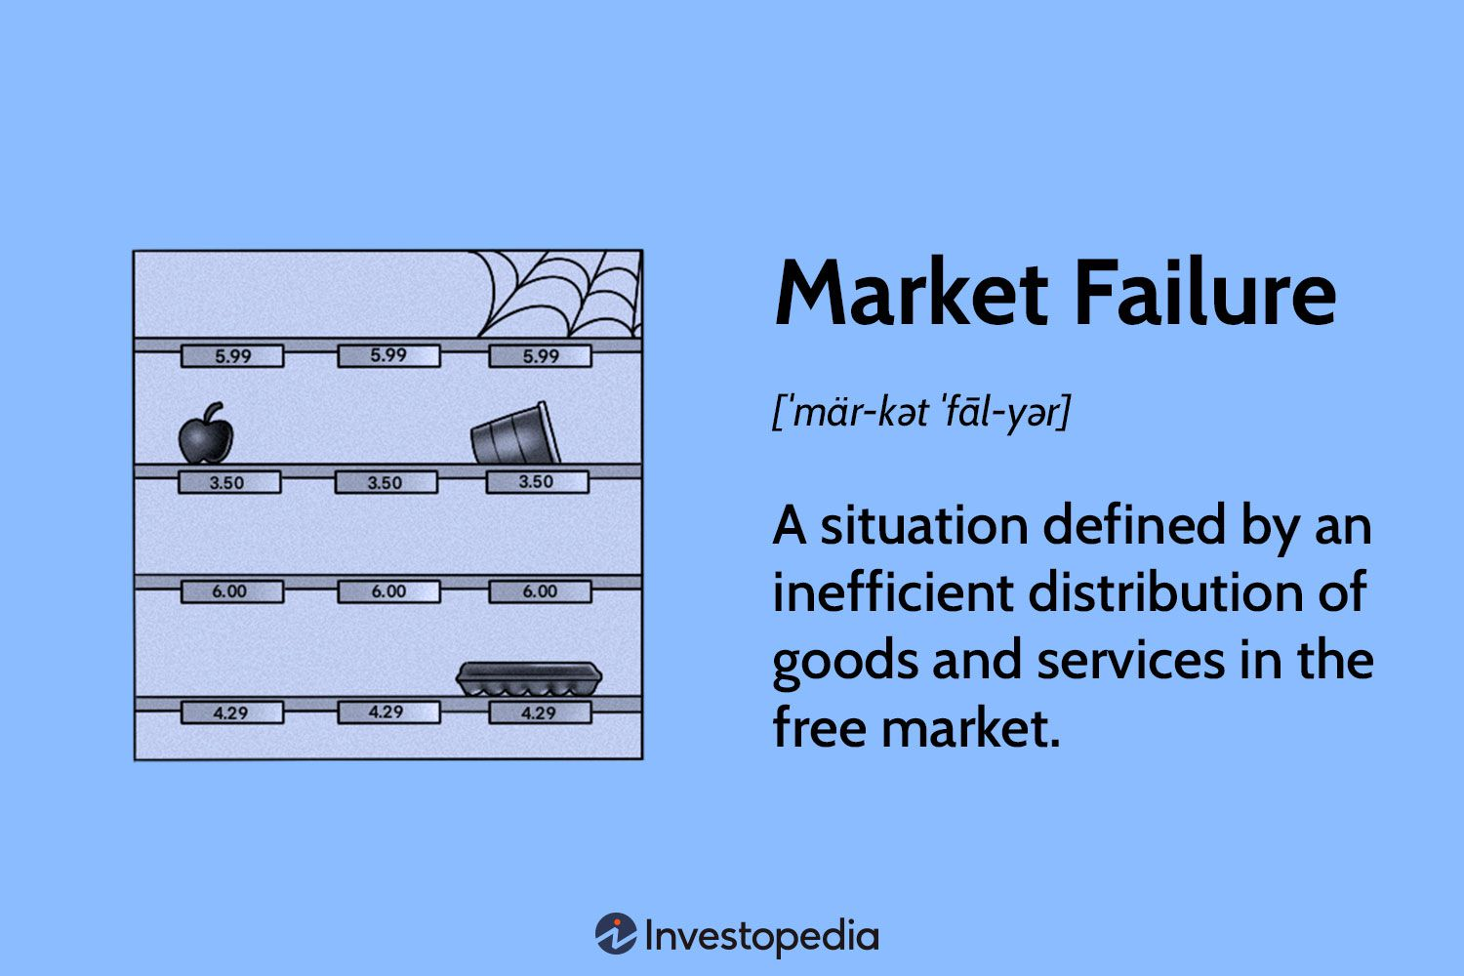

Slide 34
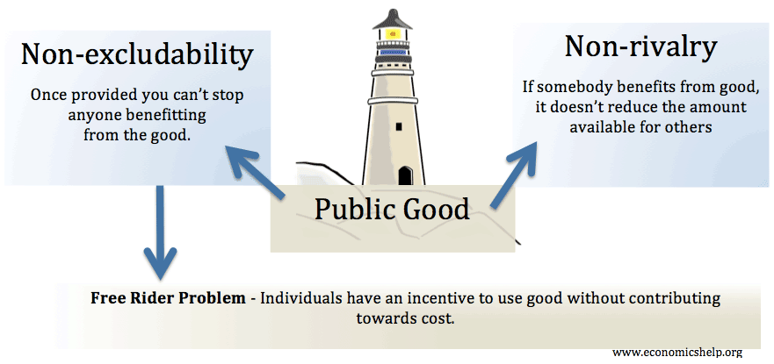

Slide 35
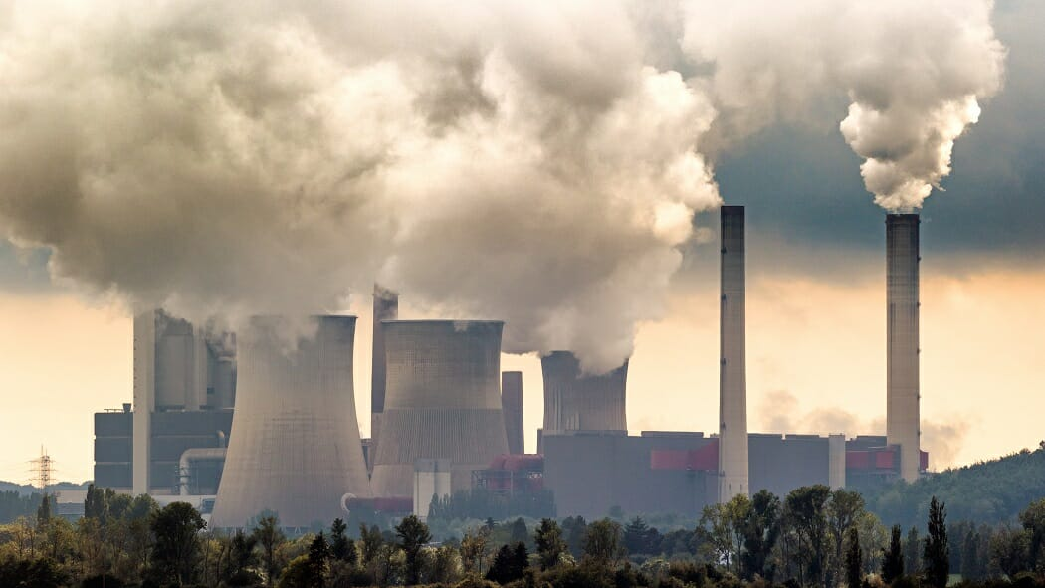
Externalities

Slide 36
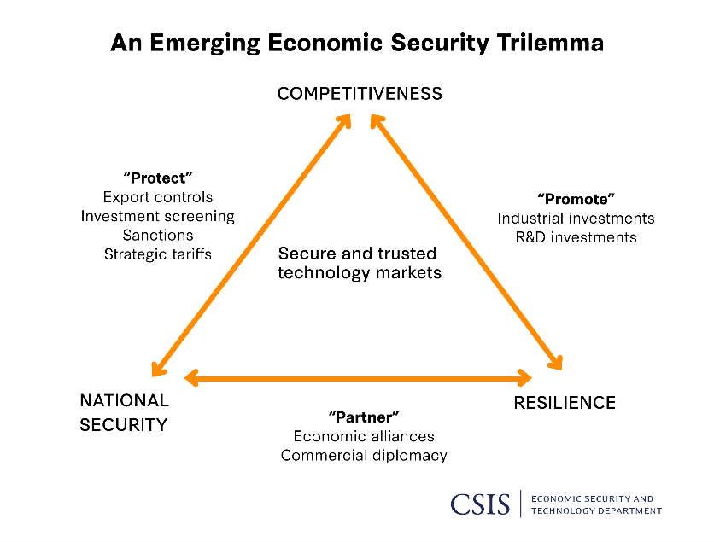

Slide 37


Slide 38
Thank you!
Any Questions?
www.NEEDEcon.org
Mina Kim
minakim@mkecon.com
Contact NEED: info@NEEDEcon.org
Submit a testimonial: www.NEEDEcon.org/testimonials.php
Become a Friend of NEED: www.NEEDEcon.org/friend.php

